Slide 1
MARCH DATA CRUNCH MADNESS COMPETITION
Team MOVA
Vanessa Asaro, Annemarie Donohue, Owakhela Kankhwende, Maria Ignacia Araya

Slide 2
1.
Data Insights
Gathering Initial Information through Visualization of the Historical Data

Slide 3
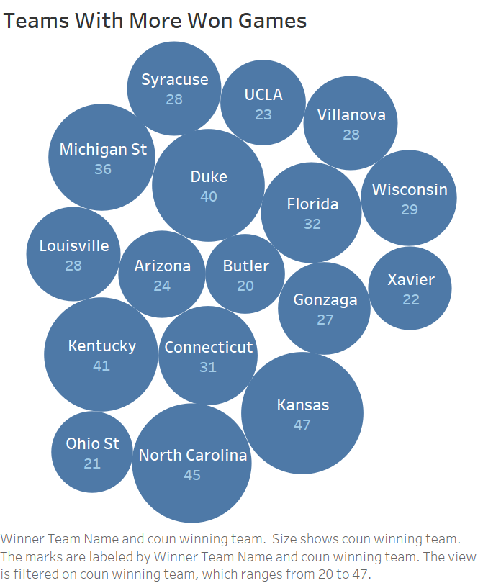
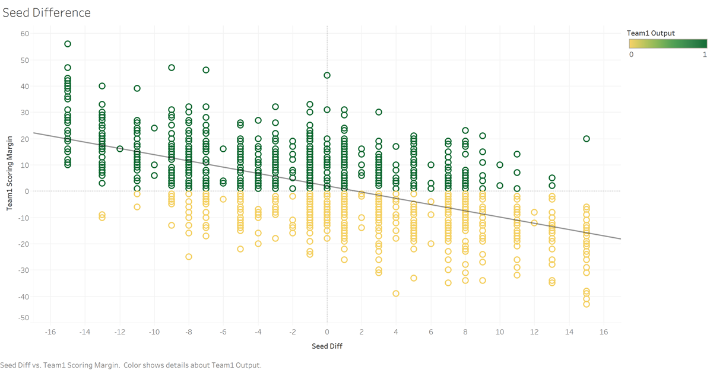
Data Insights
Team winning frequency: The teams who won the most games out of all historical March madness data are Kansas, North Carolina, Kentucky, Duke, Michigan St.
Seed: Seed difference is Team 1 seed - Team 2 seed. In numeric form a negative value indicates a higher seeded team 1. As Seed difference increases, the Scoring margin and favourable outcome for team 1 decreases.
Adjusted Tempo:Adjusted tempo for either team arose in some initial correlation matrices as a viable feature. Also as per Kevin Pomeroy and NCAA prediction enthusiasts, it’s important to account for Adjusted Tempo as the speed of a team yields some picture of possible lagging efficiency.

Slide 4
2.
Variable Selection
Inputting new variables and choosing relevant features to run through the model.

Slide 5
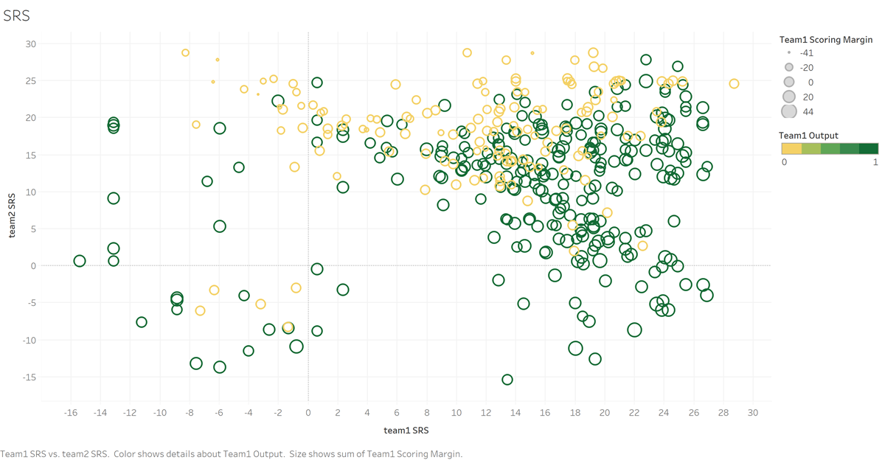
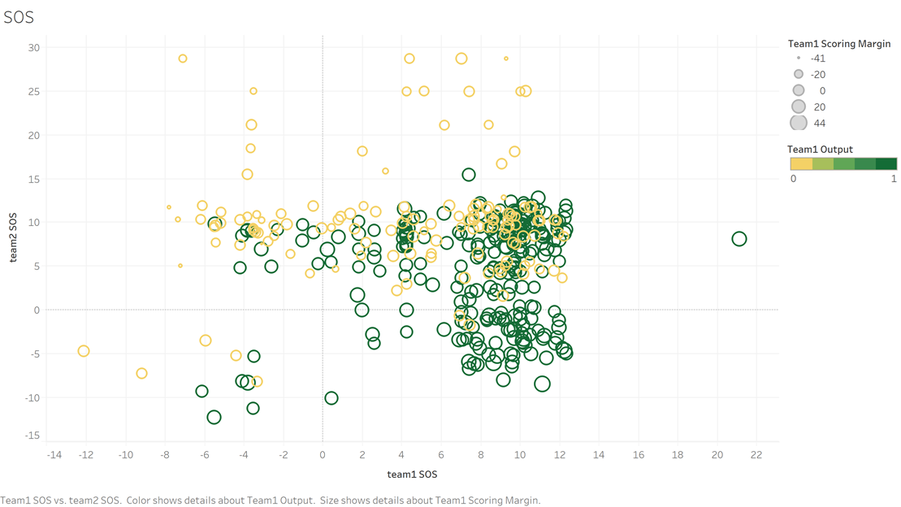
New Variables
Simple Rating System (SRS)
Rating that takes into account average point differential and SOS.
SRS difference arose as a viable feature while investigating correlation of the new variables with the result. We also found that as Team 1s SRS increases relative to Team 2s SRS, there was a observed trend of more Team 1 wins.
Strength of Schedule (SOS)
Average schedule difficulty faced by each team in the games that they have played in that season
Both Team SOS variables arose as viable features while investigating correlation of the new variables with the result. We also found that as Team 1s SOS increases relative to Team 2s SOS, there was an observed trend of more Team 1 wins.
*taken per season from Sports Reference website (1)

Slide 6
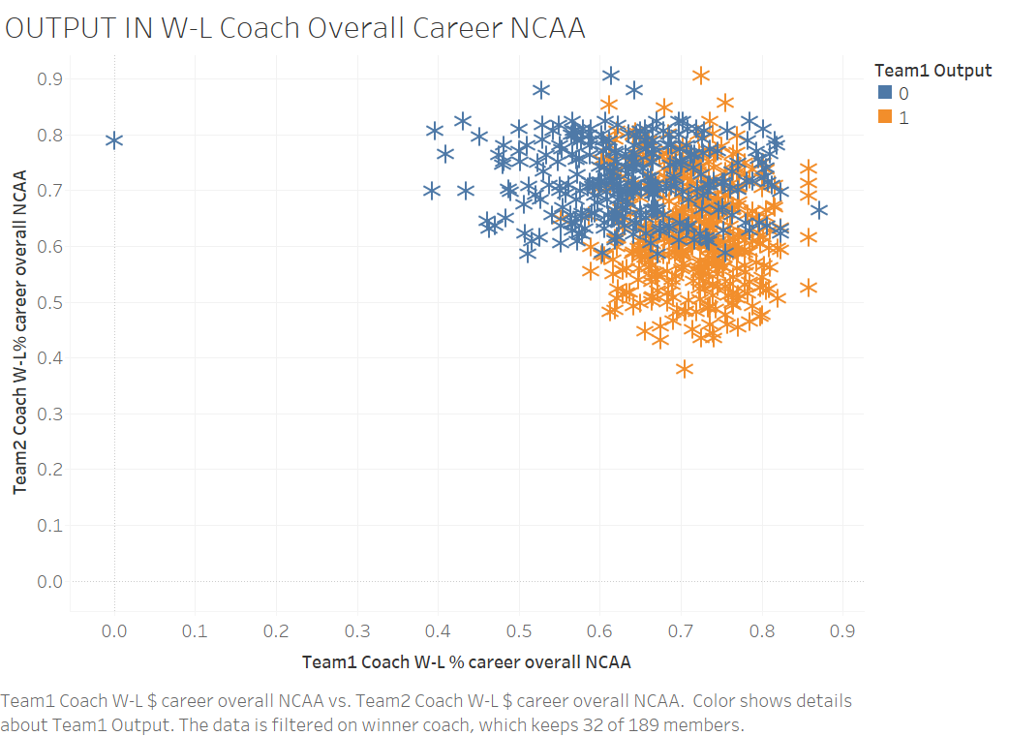
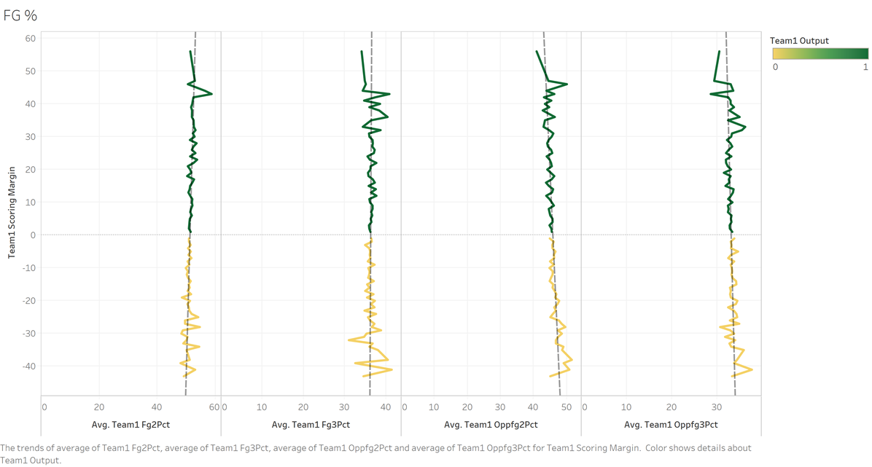
New Variables
Coach W-L% - Career Overall NCAA
Coaches win - loss percentage career overall in NCAA, filtered by the coaches that have more than 10 won games.
Calculated by Coach Wins/(Coach total)
Output: 1 for team1 and 0 for team2
Coaches are vital for mental development including communication and teamwork skills, and their participation in the team can be longer than of the players.
Field Goal Percentage (FG%)
Measure of how well team shoots ball during that season (#shots made/ #total shot attempts)
Useful for evaluating individual players on a team by team basis.
Most direct explanation of a basketball games events, as a teams FG% increases relative to their opponents and vice versa, the scoring margin and outcomes is decided.
*taken per season from Sports Reference website (1)

Slide 7
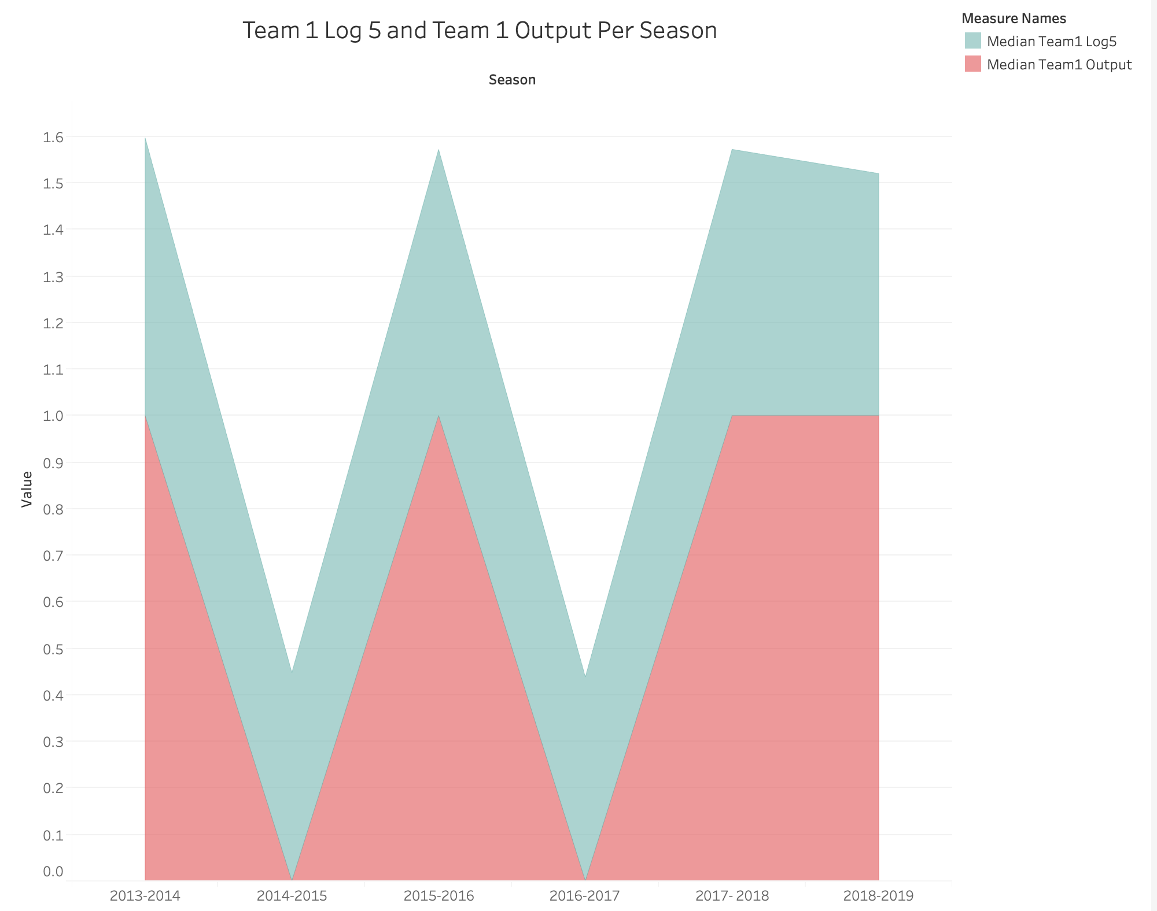
New Variables
log_5
A Teams percentage chance of winning given their pythagorean win expectation and opponent’s pythagorean win expectation
How efficient a team is offensively and defensively against average teams
Involves variables for team 1, team 2, and difference of both
Graph shows correlation between log 5 and output
Team1_output
In the historical data given, team one was always the winner.
Randomized team 1 vs team 2 in python and then made a target variable team_1 output with 1 if team 1 wins or 0 if they lose

Slide 8
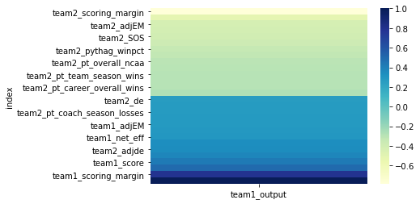
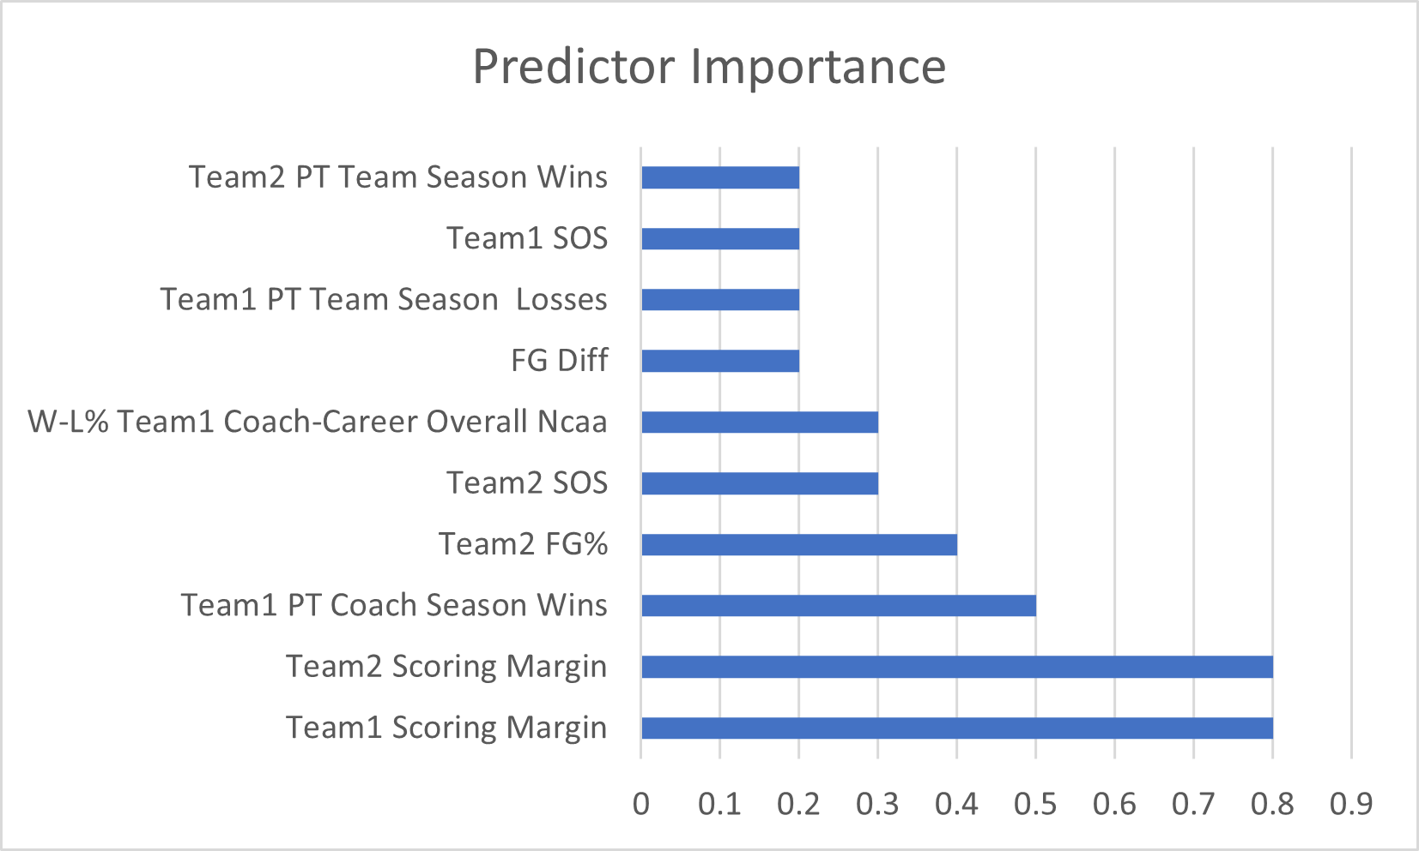
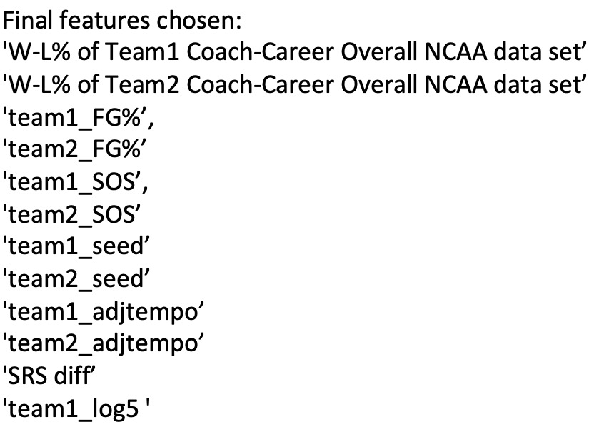
Feature Selection
Used both machine learning and statistics to help identify features most important in predicting team1_output
Created heatmap from correlation matrix which shows the highest correlations at lighter green and darker blue
Ran all variables through models and chose neural network which was used to identify predictor importance.
Included team counterpart variables so our results were balanced

Slide 9
Feature Composition
COACH
RATINGS
PERFORMANCE
W-L% COACH TEAM COACH CAREER OVERALL NCAA
TEAM STRENGTH OF SCHEDULE
SIMPLE RATING SYSTEM
TEAM SEED
TEAM FIELD GOAL %
TEAM ADJ_TEMPO
LOG 5
WINNER

Slide 10
3.
Modeling
Selecting model to run the data through and evaluating model selection choice.

Slide 11
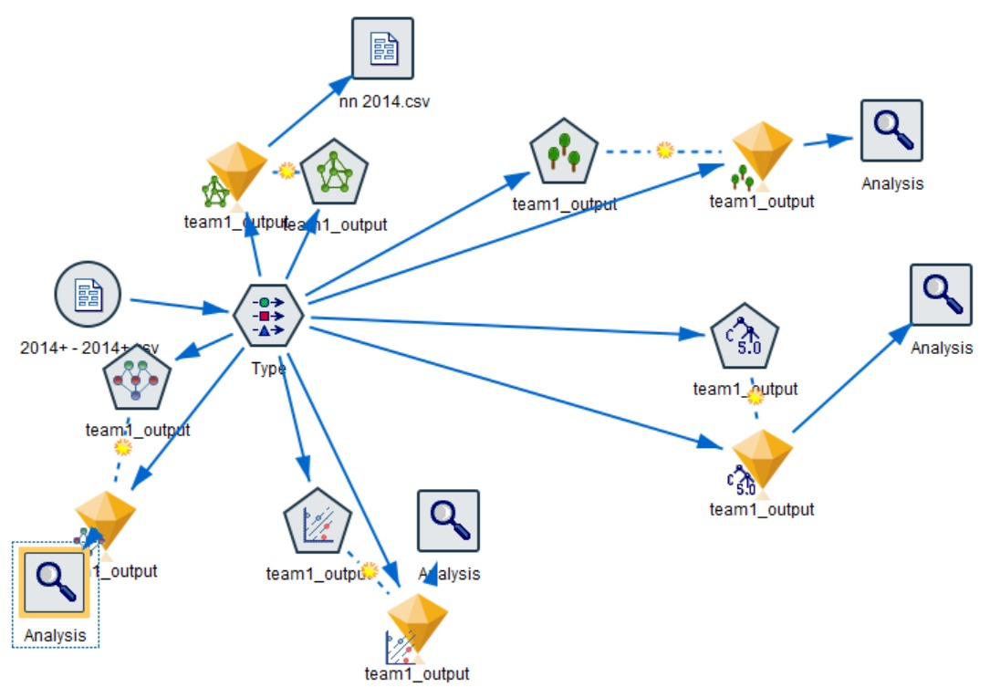
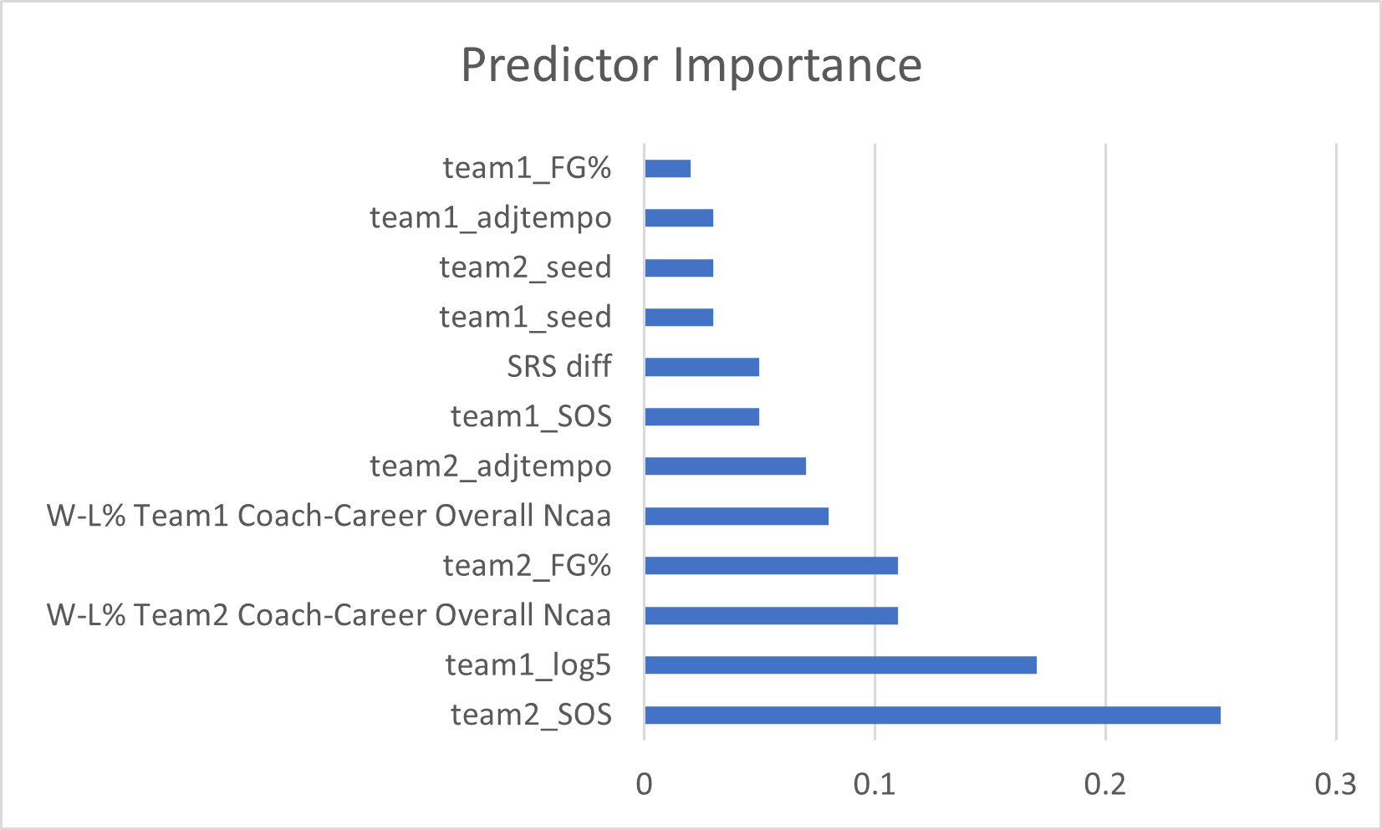
Model Building & Selection
Randomized the data so team1 winning percentage < 100%, set target to team1_output.
Training set: match data between 2014 and 2019
Testing data: match data from 2021
Compared accuracy of models::
Neutral Net, Decision Tree, Bayes, Feature Selection, Regression, LVSM
Neural network had highest accuracy
More broadly, neural networks have the advantage of modeling nonlinear and complex data, and it is great for forecasting. (2)

Slide 12
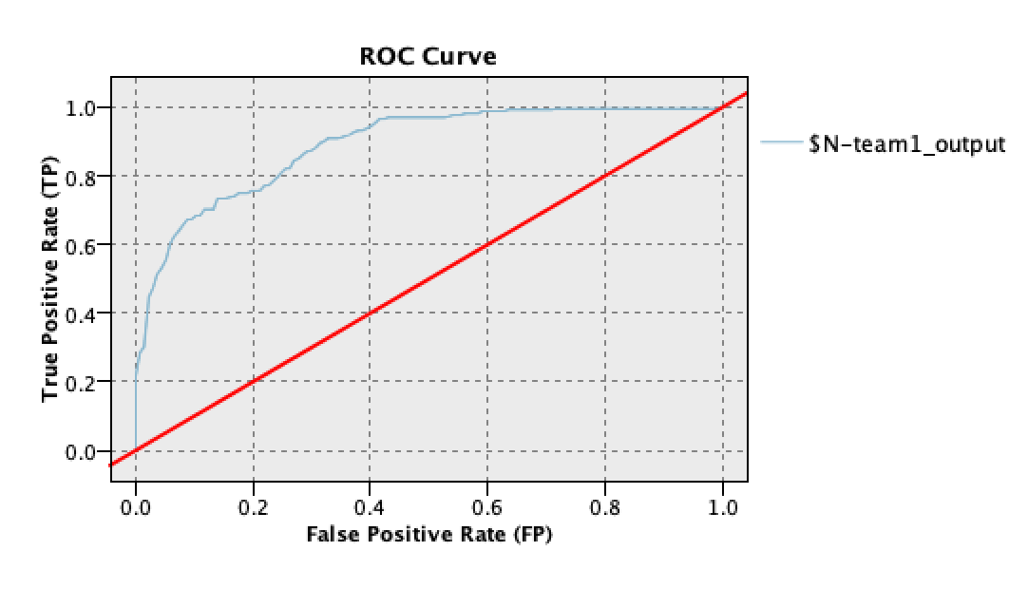
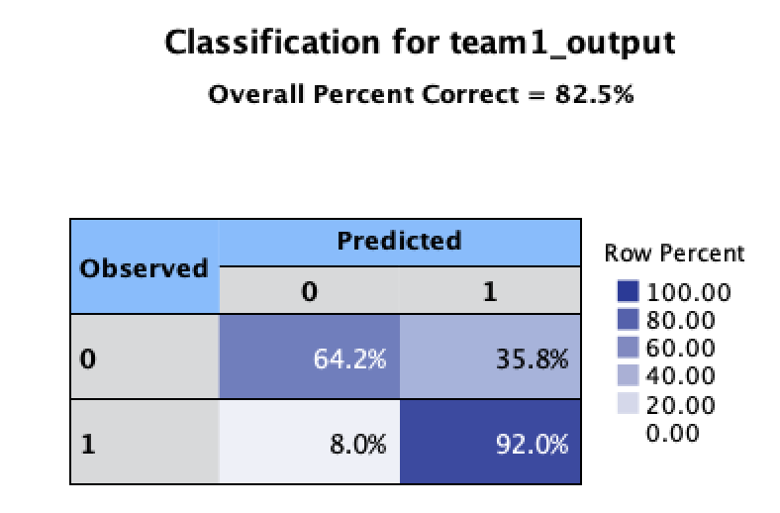
Model Results
Receiver Operating Characteristics Curve(ROC) has the accuracy score of overall performance measured as the area under the curve
The Correlation Matrix and ROC shows the true positive and false positive rate trade-off
Prediction: 1
Recall: 0.88
Precision: 0.642
Positives Predicted Right
1: 64.2%
Negatives Predicted Right:
0: 92.0%
Notes:
Neural network is good at classification. In our case we made out target variable a 1 or a 0 → so the machine learning technique classifies the target as either 1 or 0
Predictor Important- only ones we wanted
Recall:

Slide 13
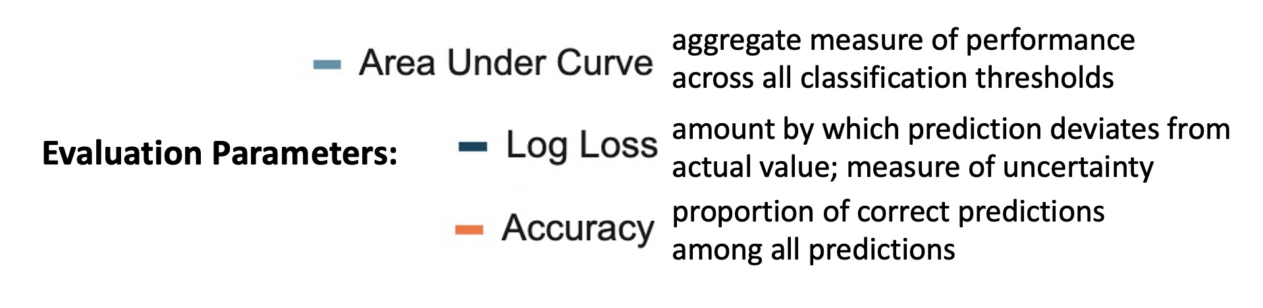
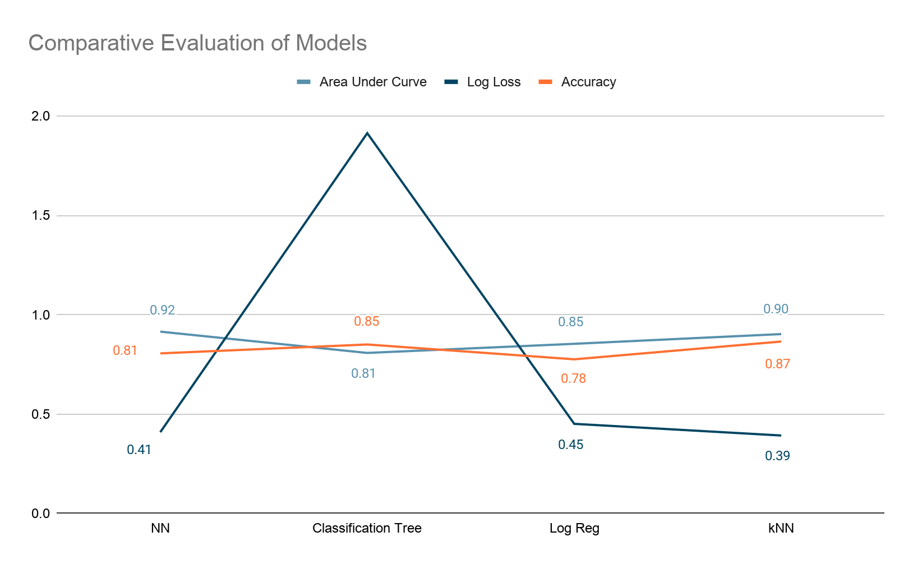
Model Evaluation
Factored in all three evaluation parameters in.
Neural Network has the best area under the curve, a great accuracy (that takes into account overfitting), and a log loss that fits into the target of (.4 - .6) while being closest to .4.
k-Nearest Neighbors has too low of a log loss
Classification Tree has too high log loss
Logistic Regression has a log loss within the target but Neural Network beats it in all other parameters as well.

Slide 14
4.
Predictions
Outcomes and predictions of March Madness 2021 using our model.

Slide 15
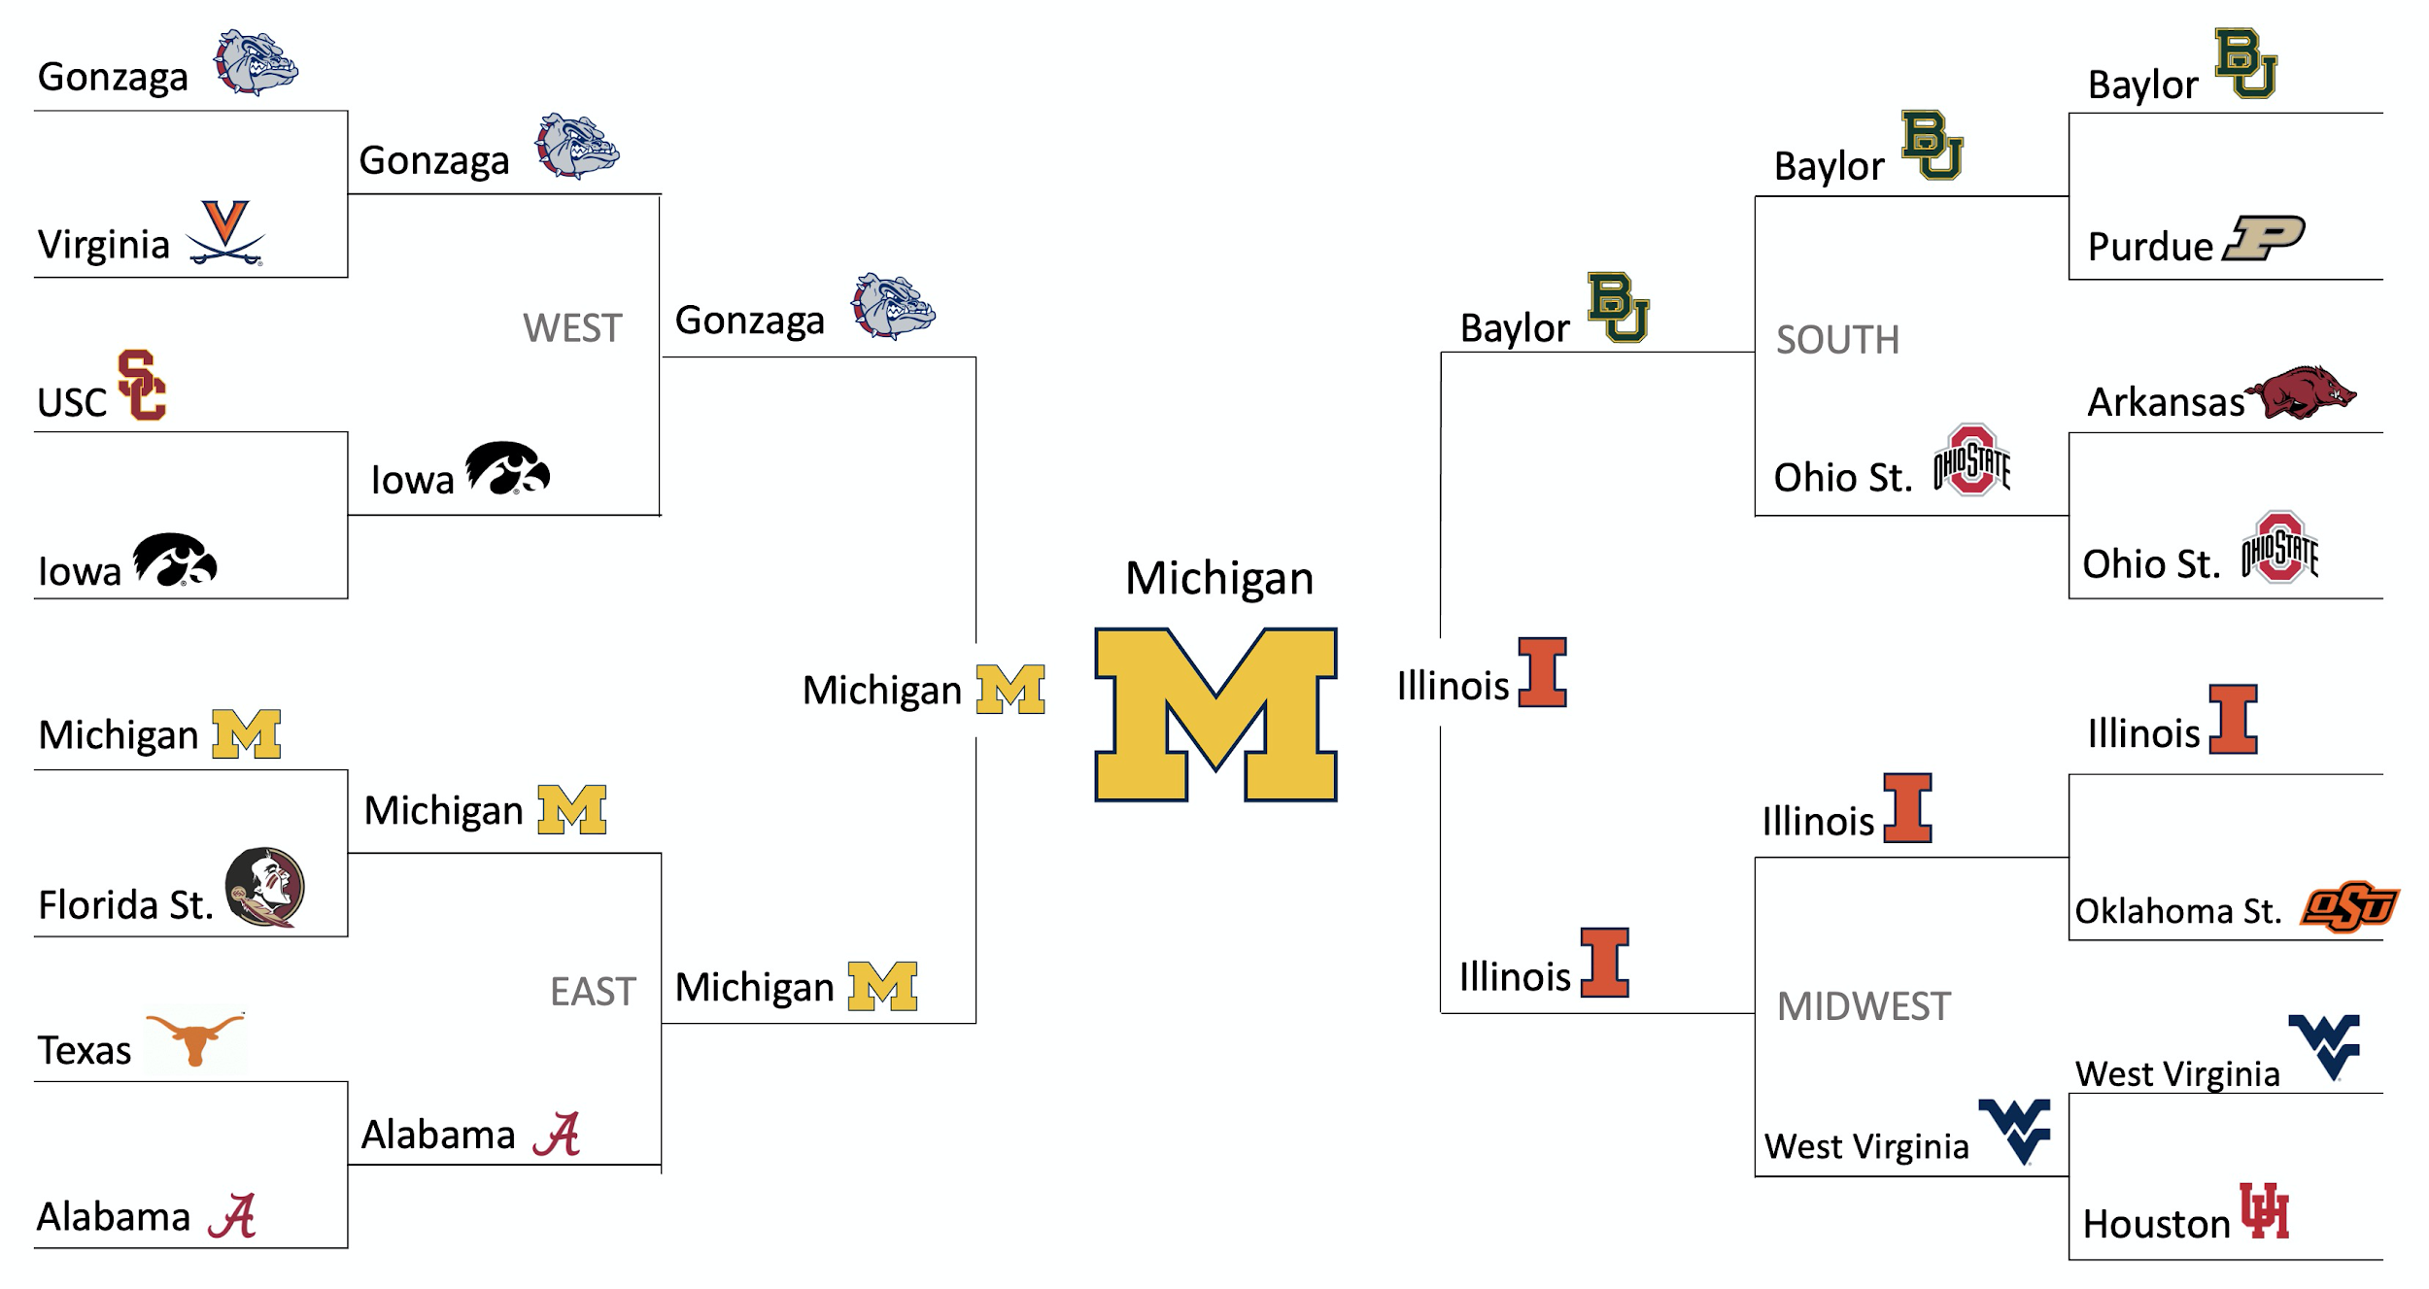
Tournament Predictions

Slide 16
Predictions/ Insights
Michigan = the Winner
Michigan has won only the championship once
Much of predictions are consistent with seed predictions
Our features were made up of multiple ranking variables
Unexpected picks from our prediction vs seed data:
9th seed was chosen to win over 8th seed twice
Upsets
When the winning team is seeded at least two seed lines better than the losing team
Our model predicted one upset: Rutgers (10th seed ) to win over Clemson (7th seed) in first round.
Close predictions: there were many bracket decisions that were very close to the .5 prediction mark
Tweaking variables or model a bit could change outcome of bracket

Slide 17
5.
Conclusions
Scope and limitations, areas for future research

Slide 18
Scopes & Limitations
Covid-19 Data Limitations
No historical data for March Marchness 2020 since it was cancelled
Could not incorporate home or away data that was relevant in past years
Selected variables are more game oriented by removing traveling attributes
Covid-19 could have impacted other variables and outcome but there is no data for it → i.e., less time building team atmosphere, etc

Slide 19
Next Steps & Future Research
Developing a thorough method of predicting upsets in the tournament
We predicted 1 upset in our data while statistically from 2007-2014 the average total upsets per year was 12.7. (3)
Inclusivity of Women’s March Madness
March Madness, Brackets, and Predictions are apart of women’s college basketball as well
Predicting womens bracket, comparative analysis of indicative features of wins between mens and womens teams.

Slide 20
Sources
https://www.sports-reference.com/cbb/seasons/
https://towardsdatascience.com/introduction-to-neural-networks-advantages-and-applications-96851bd1a207
https://www.ncaa.com/news/basketball-men/bracketiq/2018-03-13/heres-how-pick-march-madness-upsets-according-data#:~:text=We%20defined%20an%20%22upset%22%20as,better%20than%20the%20losing%20team.
https://www.maizenbrew.com/2019/10/23/20928669/kenpom-explained-what-it-means-michigan-basketball-ranking

